Slide 1
Dell EMC e Docker: Achieving Infrastructure as Code and Container persistence
Rich Barlow
Principal Engineer and Field CTO
Rich.Barlow@Dell.com

Slide 2


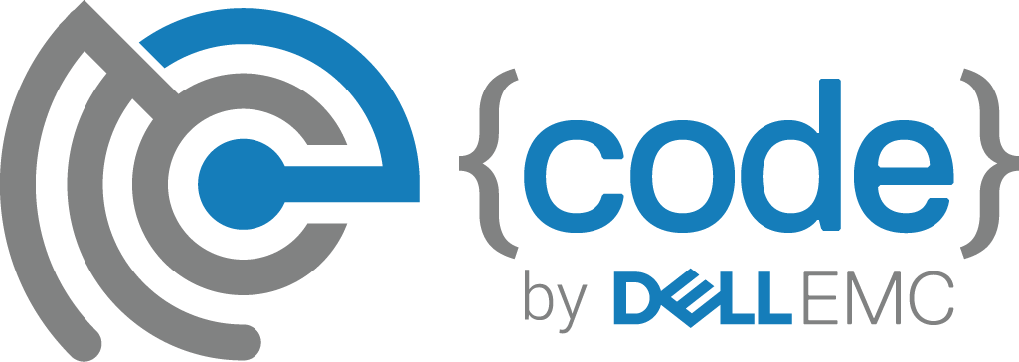
Containers
Devops
Confluence of 4 forces
Agile
Microservices
Notes:
We hear a bunch recently about containers, and microservices and devops and how they fit together.
We think there are 4 forces in the industry right now, influencing each other and giving rise to the cloud native application.

Slide 3
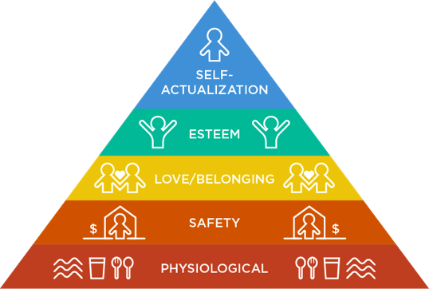
Maslow’s Hierarchy of Needs
Notes:
Maslow's hierarchy of needs is a theory in psychology proposed by Abraham Maslow in his 1943 paper "A Theory of Human Motivation" in Psychological Review.[2] Maslow subsequently extended the idea to include his observations of humans' innate curiosity. His theories parallel many other theories of human developmental psychology, some of which focus on describing the stages of growth in humans. Maslow used the terms "physiological", "safety", "belongingness" and "love", "esteem", "self-actualization", and "self-transcendence" to describe the pattern that human motivations generally move through.
The most fundamental and basic four layers of the pyramid contain what Maslow called "deficiency needs" or "d-needs": esteem, friendship and love, security, and physical needs. If these "deficiency needs" are not met – with the exception of the most fundamental (physiological) need – there may not be a physical indication, but the individual will feel anxious and tense. Maslow's theory suggests that the most basic level of needs must be met before the individual will strongly desire (or focus motivation upon) the secondary or higher level needs. Maslow also coined the term "metamotivation" to describe the motivation of people who go beyond the scope of the basic needs and strive for constant betterment.[7]
The human mind and brain are complex and have parallel processes running at the same time, thus many different motivations from various levels of Maslow's hierarchy can occur at the same time. Maslow spoke clearly about these levels and their satisfaction in terms such as "relative", "general", and "primarily". Instead of stating that the individual focuses on a certain need at any given time, Maslow stated that a certain need "dominates" the human organism.[3] Thus Maslow acknowledged the likelihood that the different levels of motivation could occur at any time in the human mind, but he focused on identifying the basic types of motivation and the order in which they should be met.

Slide 4

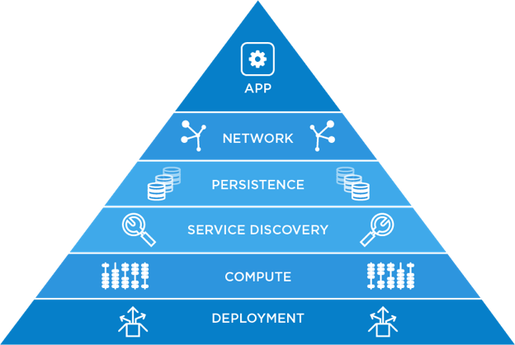
Operating 3rd Platform Infrastructure

Slide 5
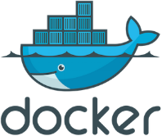
Containers are Key
Lightweight
Becoming defacto application packaging standard
Package of software binaries and dependencies
Easily portable across environments (on-prem and cloud)
Allows ecosystem to develop around its standard
Docker, Cloud Foundry, Mesos, and Kubernetes are currently the most popular container technologies
A persistent container stores data in an external volume
Additionally an opportunity to run some old applications in new ways
Code and
Dependencies
Container

Slide 6
HOW IS DELL EMC OPERATING IN THIS SPACE?
Notes:
We hear a bunch recently about containers, and microservices and devops and how they fit together.
We think there are 4 forces in the industry right now, influencing each other and giving rise to the cloud native application.

Slide 7
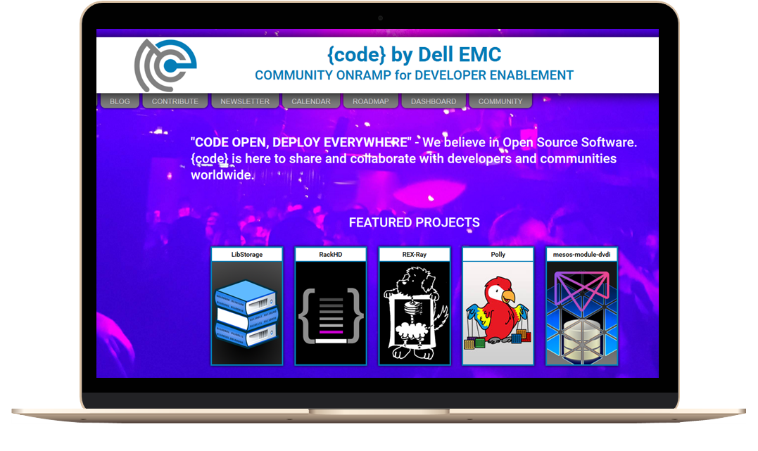
Enable Dell EMC to be relevant in DevOps and open source communities through contribution, engagement and technical solution leadership.
codedellemc.com

Slide 8
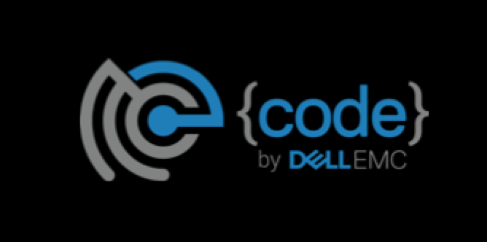
Keys to Freedom and Flexibility
Embrace DevOps and open source
Remove unnecessary complexity
Run many applications from containers
Operate everything as software, including storage
Run applications as services
Use platform that orchestrates and consumes all infrastructure natively for applications

Slide 9
LET’S GO BACK TO THE PYRAMID ;)
Notes:
We hear a bunch recently about containers, and microservices and devops and how they fit together.
We think there are 4 forces in the industry right now, influencing each other and giving rise to the cloud native application.

Slide 10
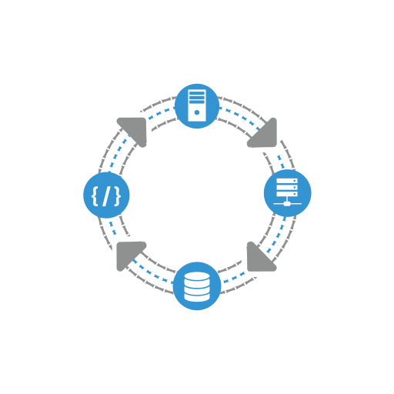
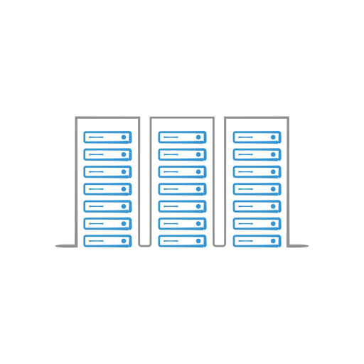
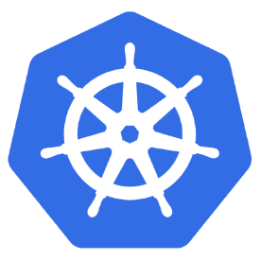
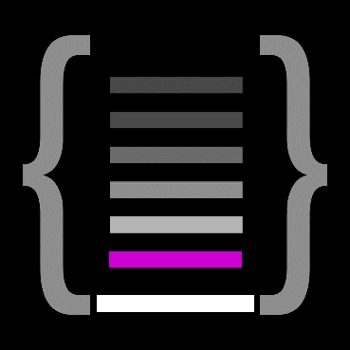
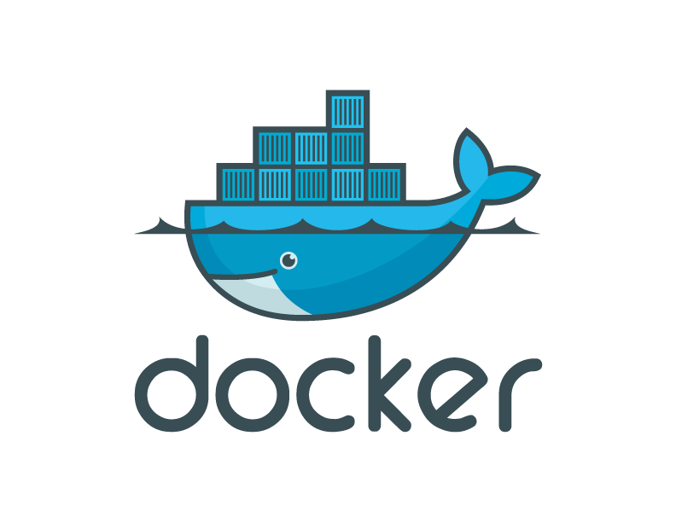
1. Deployment and Compute
RackHD
github.com/rackhd
Notes:
When a node is first discovered by RackHD, data is collected from sources such as dmi, lshw, lspci, IPMI, ohai, etc. You may not know what these are, but the results end up in catalogs that you can use to access fine-grained details about the motherboard, processor, manufacturer, firmware versions, etc. You then define rulesets to categorize a machine into a SKU. Examples would be “nodes with an Intel chipset go in a SKU named ‘Intel'”

Slide 11
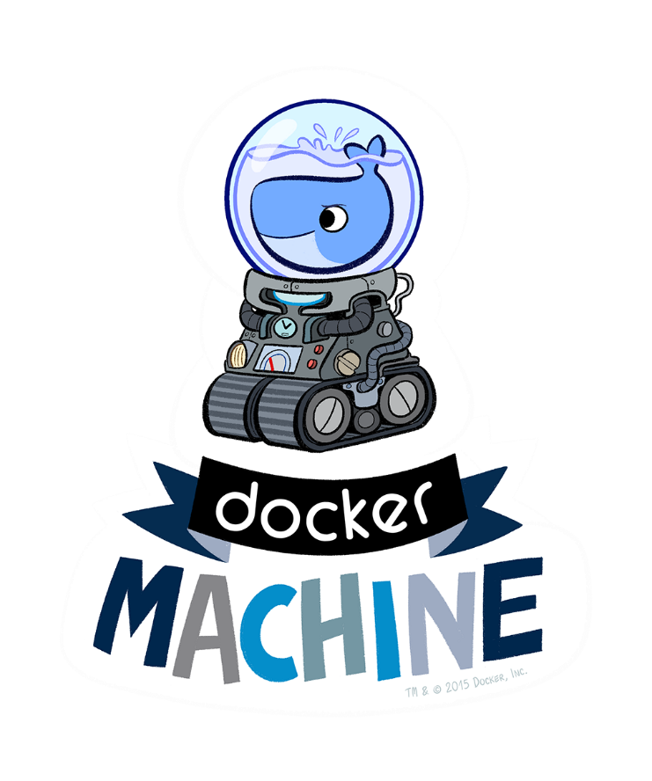
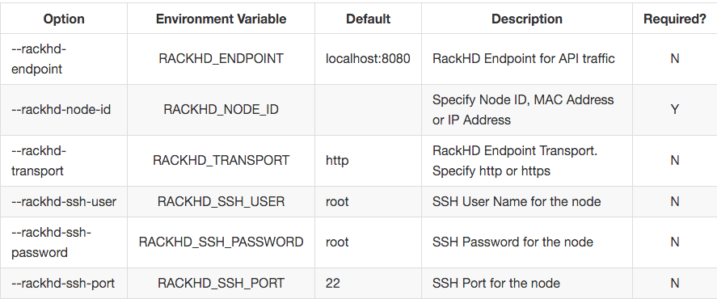
Docker Machine Driver for RackHD
https://github.com/emccode/docker-machine-rackhd
Notes:
With this new release, a RackHD workflow can be applied to the node at provision time, allowing for OS installs. Additionally, a user no longer has to specify a RackHD node to use; rather, they can specify a SKU and the Driver will automatically pick a node for you.
http://kendrickcoleman.com/index.php/Tech-Blog/how-to-use-volume-drivers-and-storage-with-new-docker-service-command.html

Slide 12


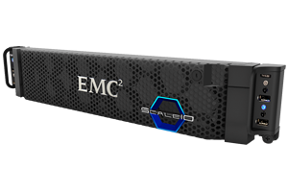
2. Software-based Storage
Enabler for DevOps
Freedom and flexibility from running as software
Lifecycle can be automated
High availability is automatically configured per host
Size and performance scales out and up
Optimized for transactional block performance
github.com/codedellemc/demo

Slide 13
ScaleIO – How does it work?
SERVER #1
SERVER #2
SERVER #N
RAM
RAM
RAM
CPU
CPU
CPU
CPU
CPU
CPU
CPU
CPU
CPU
CPU
CPU
CPU
Local Disk (SSD)
Local Disk (HDD)
Local Disk (SSD)
Local Disk (HDD)
Local Disk (SSD)
Local Disk (HDD)
ScaleIO – SDS
(Virtualized Storage Array)
ScaleIO – SDS
(Virtualized Storage Array)

Slide 14
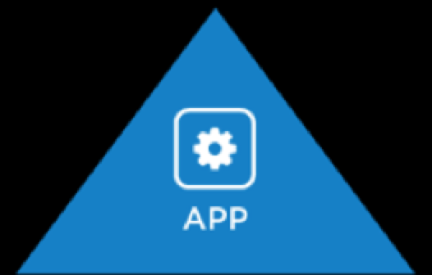

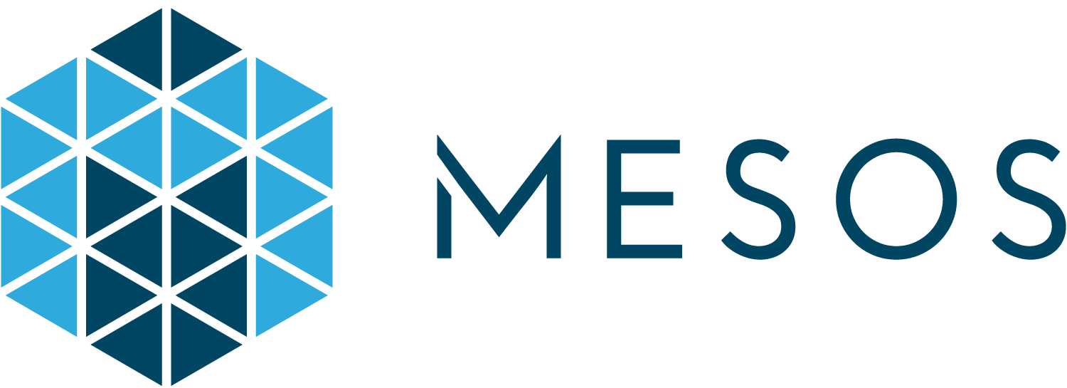
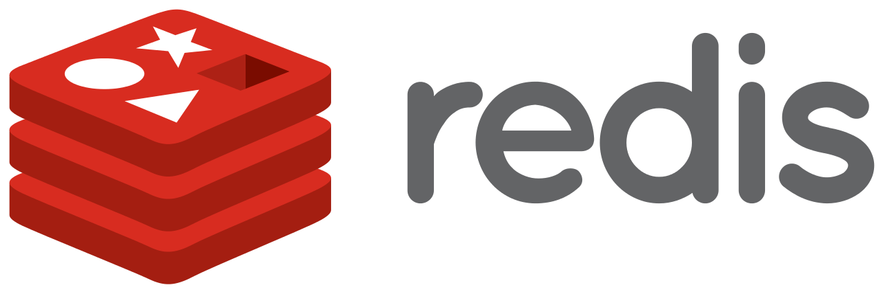

3. Persistent Applications as Services
Dedicated, shared, and hyper-converged compute nodes
github.com/codedellemc/scaleio-framework
Notes:
The ScaleIO Framework deploys Dell EMC ScaleIO as a simplified task in Apache Mesos. All the required components to consume and provision storage volumes from a ScaleIO cluster are automatically deployed and configured on the Mesos Agents. This creates an automated mechanism to have a fully configured and reliable persistent storage solution for containers running on Apache Mesos.

Slide 15


4. External Storage and Containers
REX-Ray is an open source vendor agnostic storage orchestration engine
Required for properly operating persistent applications in containers
Brings external volumes to container hosts
Enables ephemeral containers to connect to external volumes
github.com/emccode/rexray
*Works with docker service and swarm mode
Notes:
The nature of the docker service command means it will restart containers on a different host if the docker daemon is unreachable. Small plug here for my EMC {code} group, but REX-Ray is one of the only available volume drivers that has High Availability built-in so the process of forcefully unmounting a volume from a host so it can be mounted elsewhere is done. Lastly, --replicas just makes sure there is always 1 instance of it running because we don't want to have multiple containers trying to have read/write access to the volume. However, you can create a secondary service that has read-only access and runs on the same host as the pg service to read from the mypgdata mount using constraints.

Slide 16

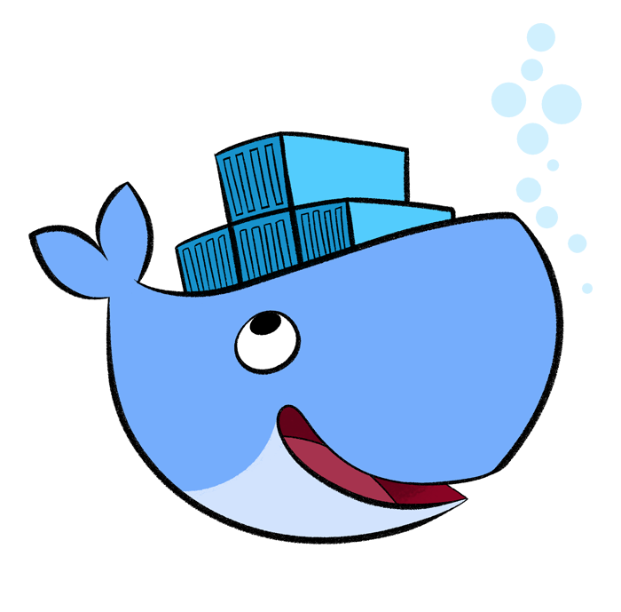
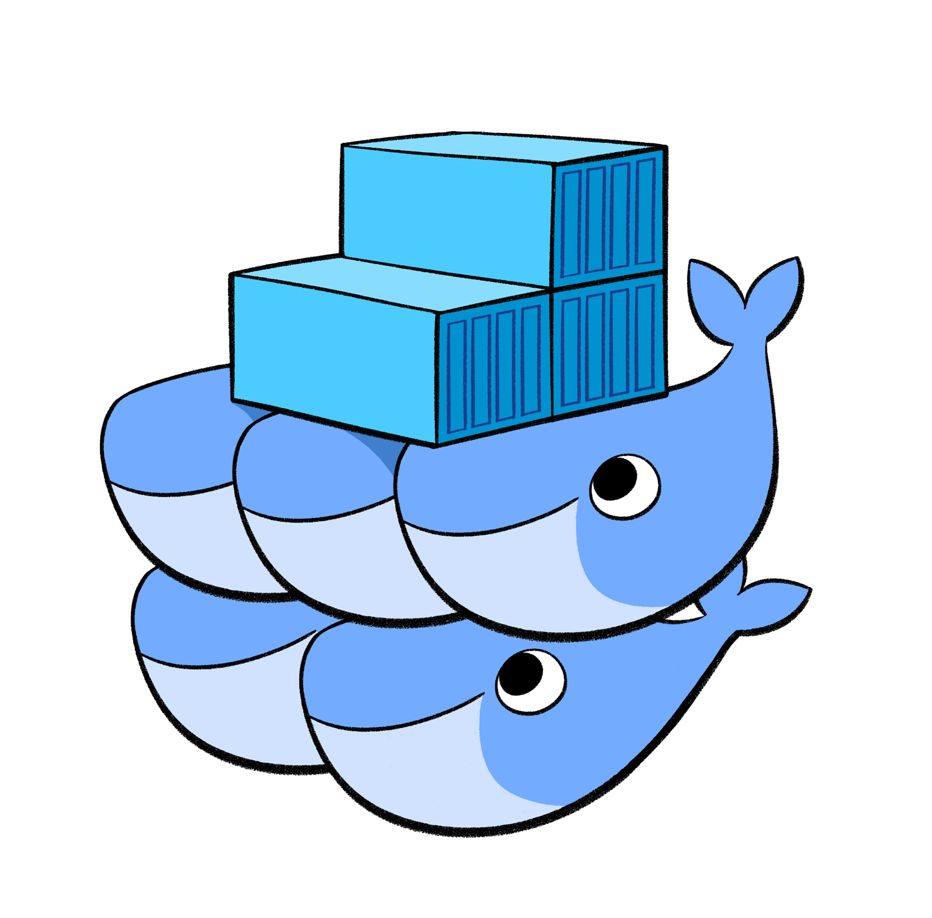


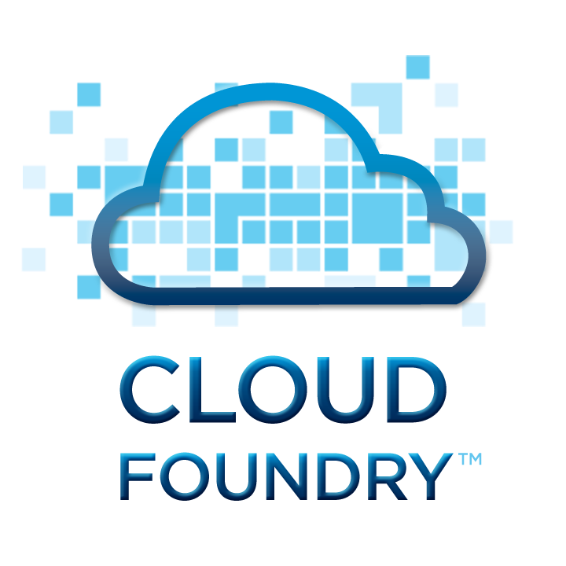
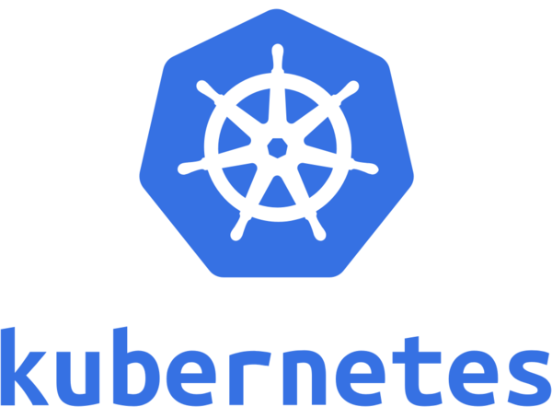
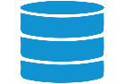
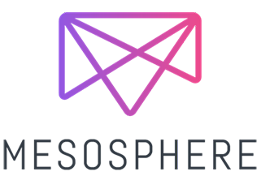

Application Platforms and REX-Ray
> docker run
–volume-driver=scaleio
-v redisv:/data
redis
X
Redis Container
Redis Container
ScaleIO Volume
REX-Ray
REX-Ray
REX-Ray

Slide 17
NOW we are getting somewhere
Persistency layer
Rackspace
Dell EMC
AWS
GCE
OpenStack
Virtualbox

Slide 18
And NOW is getting INTERESTING
Mesos
Cloud Foundry
Kubernetes
Persistency layer
Rackspace
Dell EMC
AWS
GCE
OpenStack
Virtualbox

Slide 19



ENGAGE OUR OSS PROJECTS @
github.com/codedellemc
codedellemc.com/community
Follow us: @codeDellEMC
@FabioChiodini

